Slide 1
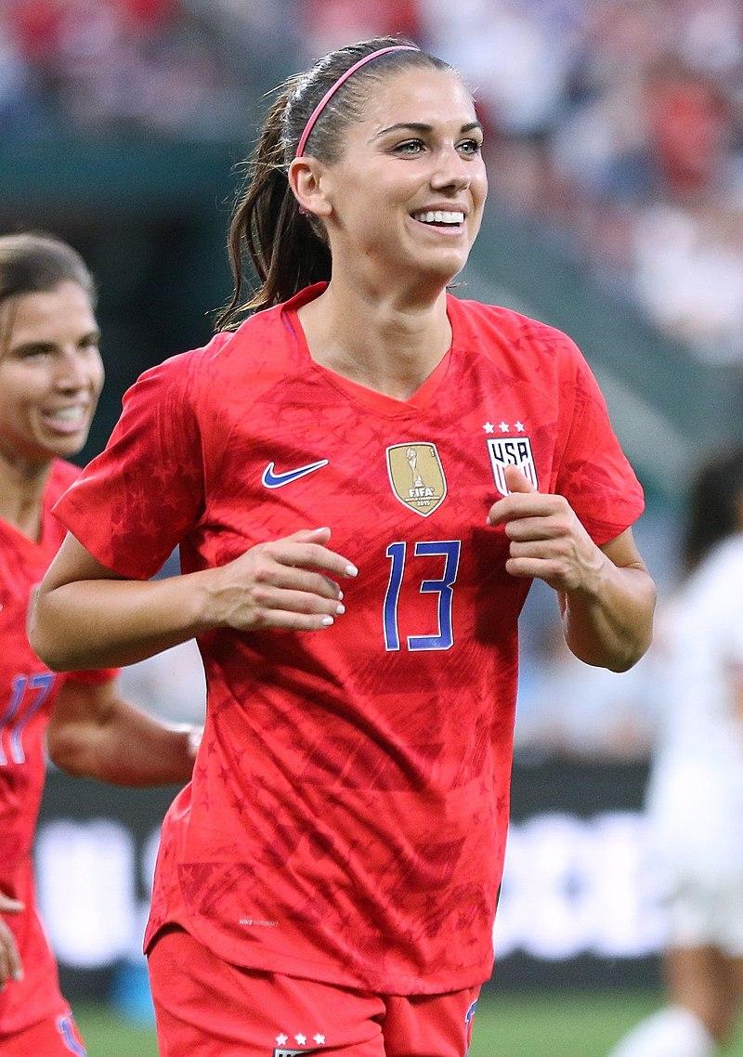
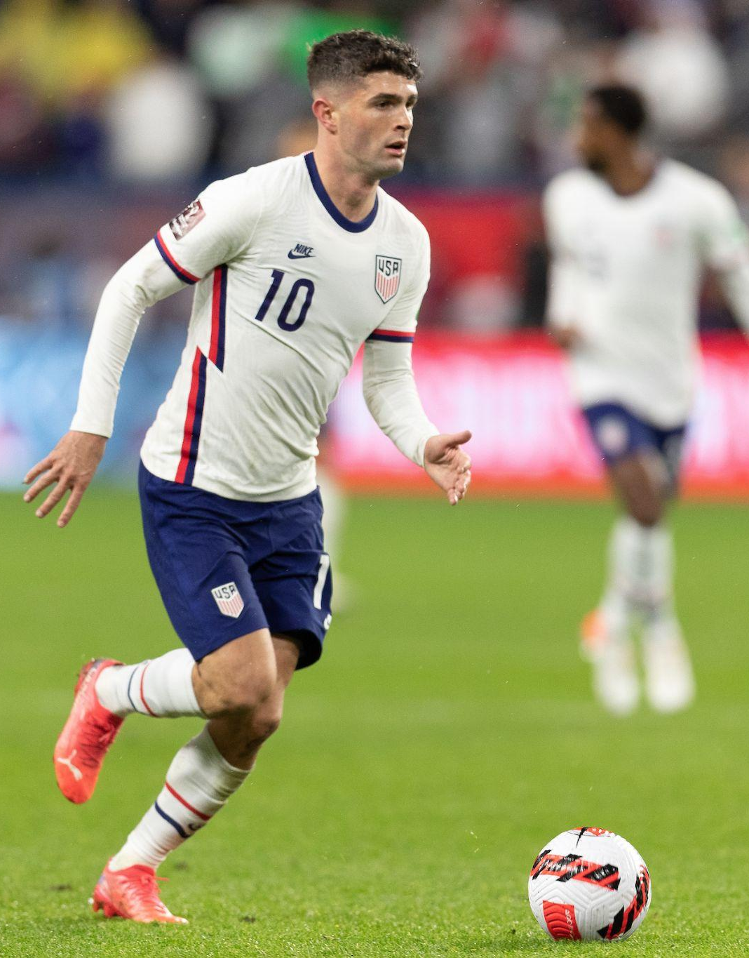
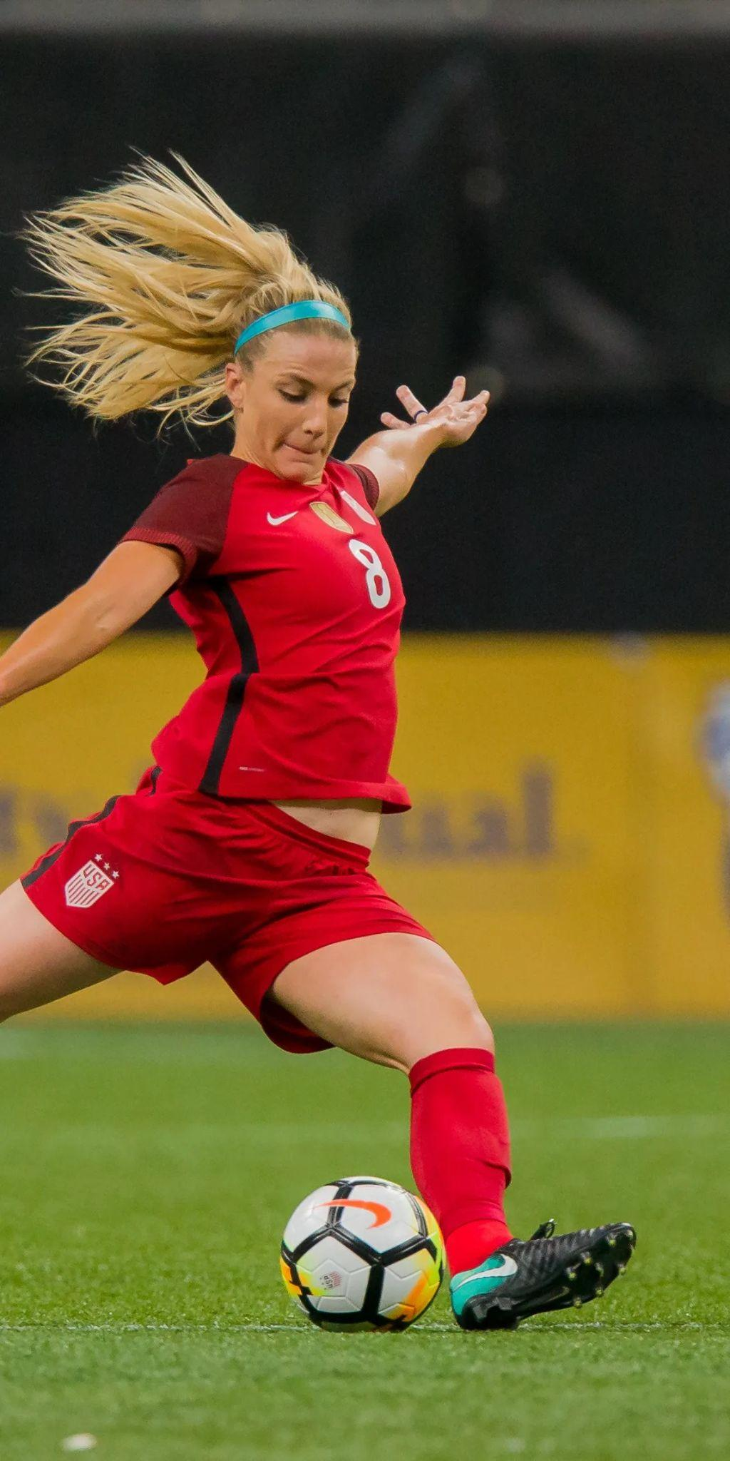
#34 John Smith
Text from parents
Text from parents
Text from parents
Text from parents
Text from parents
Text from parents

