Slide 1
Fall Walton Parent information meeting
2017-2018 Season

Slide 2

Coaches’ expectations
Attendance, punctuality, and communication
Playing time is earned and should not be expected
Communication between parents, coaches will be professional
48 hour post match communication

Slide 3
Fall player meeting
Players must have their physicals completed and turned into our trainers before tryouts
Grades must be maintained. Players can only fail one class to be eligible. Talk with coaches if you are struggling in a class.
All players and parents should already be on our email distribution list. If you aren’t please give the coaches your information before you leave
Alcohol and drug policy – in alliance with the behavioral contract – 24/7 – in and out of country
Pre-season workouts have already begun
Monday/Wednesday/Thursday 4:15-5pm
Wednesdays are ran by the seniors – with the ball – no coaches present
Gives the players an opportunity to meet returning players and new coaches
Sets expectations throughout the season
Not mandatory, but encouraged

Slide 4
Try-outs
Boys
January 15th – 9AM – 1st day
January 15th – 3pm
January 16th – 6AM – 2nd day
January 16th – 3:30pm
January 17th – 6AM – 3rd day
January 17th – 3:30pm
January 18th – 3:30pm
January 19th – 3:30pm
Girls
January 16th – 1st day – no cuts
January 17th – 2nd day – 1st round of cuts
January 18th – 3rd day – 2nd round of cuts
January 19th – final cuts
Posted on website via designated numbers
Managerial positions are still available

Slide 5
Fundraisers
Atlanta falcons
November 11th – 11am
November 25th – 11AM
December 3rd – 6AM
December 30th – 11AM
Parent Booster Club Positions are needed to be filled
Please speak with coaches after this meeting if you are interested
Raider cards
Receive raider cards during Opening banquet
20 cards/player
All cards sold by February 9th

Slide 6
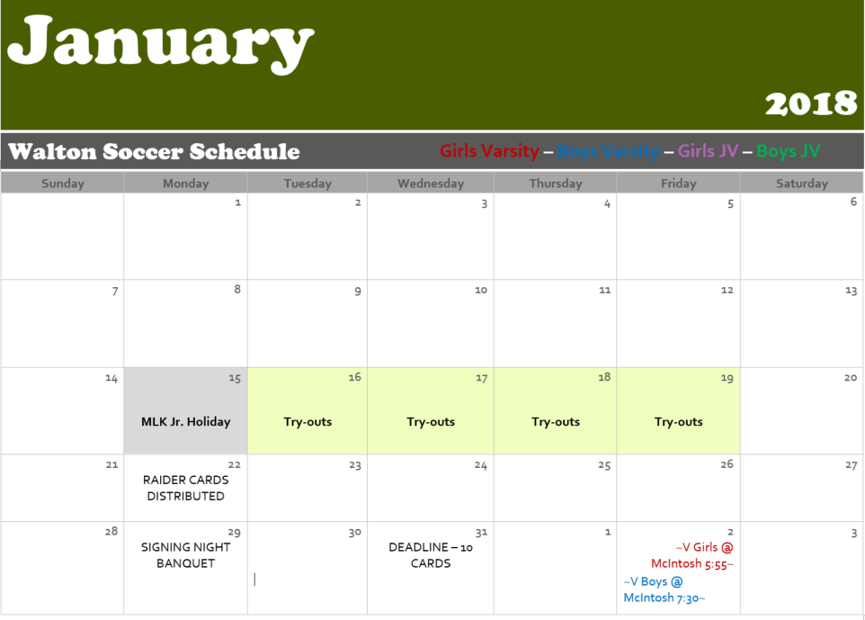
Season Calendar

Slide 7
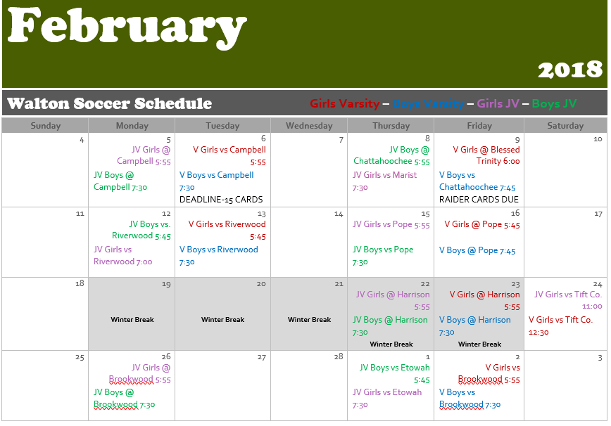
Season Calendar

Slide 8
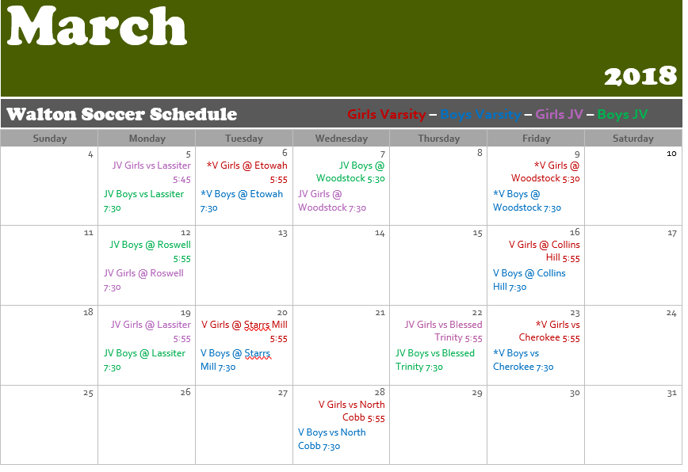
Season Calendar

Slide 9
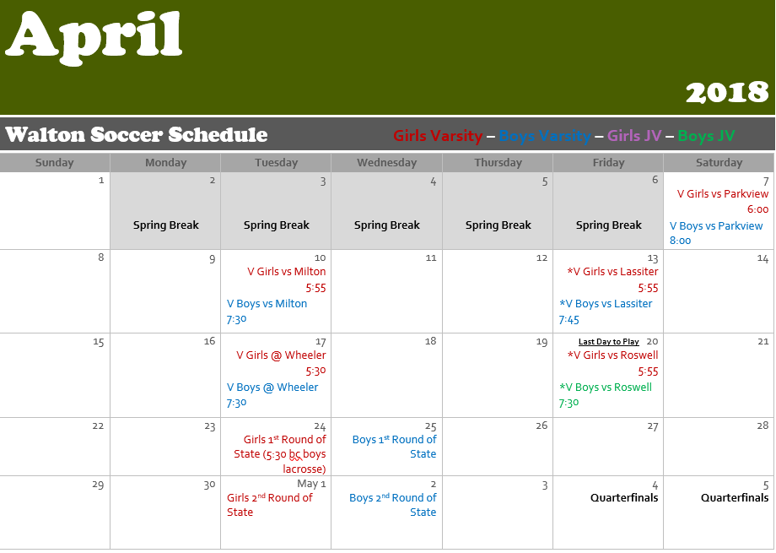
Season calendar

